Slide 1

GO TEAM MEETING #1
September 29, 2025

Slide 2
AGENDA
Call to Order
Roll Call; Establish Quorum
Action Items
Approval of Agenda
Approval of Previous Minutes:
Vote on Community Member
Discussion Items
School Strategic Plan
Strategic Plan & Priorities Review
SMART Goals
Data Discussion
MAP Results
2025 GA Milestones Results
Information Items (Principal’s Report
Enrollment and Leveling Updates
Additional Information Items
APS Forward 2040 –Comprehensive Long-Range Facilities Plan Update
Announcements

Slide 3
2021-2025 STRATEGIC PLAN

Slide 4

Through a continuing culture of equity, trust, and collaboration, every student will graduate ready for college, career, and life with a dedication to community involvement and service.
An inclusive, culturally sustainable school community where educators inspire, families engage, and students are passionate about learning and preparing for their rapidly changing world.
Mission
Vision
SMART Goals
The percentage of students who graduate in 4 years will increase from 89.8% to 93% in June 2025
The percentage of students in grades 9-12 attending school will increase from 86% to 90% according to the districts ADA (from APSgraphs)
Maintain 80% participation rate on the school climate survey and use this data to implement 3 school wide improvements by August 2025.
Provide a minimum of 10 opportunities per semester for parents to engage and participate in the school community by May 2025.
APS Strategic Priorities & Initiatives
School Strategic Priorities
School Strategies
Offer a rigorous and culturally sustainable curriculum that prepares students for college, career, and civic engagement
Ensure a safe and effective learning environment that encourages student engagement and quality work
Use existing and appropriate tools to measure, analyze, and communicate student progress
1A. The master schedule includes over twenty AP classes and a significant offering of honors classes. Various student data is used to identify potential enrollees in these higher level courses, and students are encouraged to reach beyond their comfort zones for a reasonable challenge. Course additions include: Women’s Literature, African American Studies, Forensic Science, Advanced Financial Algebra, Physical Science & Music Technology 1B. We provide opportunities for students to take college courses through the Dual Enrollment Program at a variety of academic institutions in Georgia. 1C. CTAE programs will continue the process of achieving industry certification.
2A. Administrators will support teachers’ efforts to minimize classroom disruptions and protect instructional time. 2B. Continue to build a master schedule that incorporates protected time for PLC’s. 2C: Proactive process in place to prevent student failure (Edgenuity, GradU, Knight School, Academic Support Coach, Saturday School, etc. ). 3A. All content areas will continue to use frequent common formative assessments to gauge student mastery and prescribe individualized remediation. 3B. Further our work regarding teacher consistency: developing learning targets, identifying focus standards, defining student success criteria, creating/modifying common assessments, and specifying remediation activities. 3C. All teachers keep Infinite Campus up to date utilizing equitable grading practices; Continue use of the Schoology, learning management system, as a clear, current, and a key tool for students and parents to support their academic success.
Fostering Academic Excellence for All Data
Curriculum & Instruction Signature Program
Building a Culture of Student Support
Whole Child &
Intervention Personalized Learning
4. Create a welcoming, inclusive, and responsive school culture embracing the diverse communities that comprise the Midtown family.
5. Build teacher and counselor knowledge, understanding, and skills to meet the diverse social and academic needs of students.
4A. Continue use of Chris 180, an on site mental health services provider. Ernst and Young partnership that builds a cohort of students who will be supported and nurtured from their junior year of high school through their first year of college. We have added a 5th counselor and 2nd social worker in response to student and families needs. Social workers will work to re-establish positive relationships with cluster transitional housing facilities. 4B. Parent conferences will be held 2 Tuesday’s a month using a systematic format that provides access and equity to all families to engage directly with their children’s teachers. 4C. Offer a broad selection of clubs and organizations that appeal to the wide range of interests of our diverse student body. 4D. Build a robust co-teaching program through the curriculum through the additional support of a consultant who will provide professional learning, classroom observations, and teacher coaching. Offer ongoing parent learning sessions focused on issues pertaining to students with disabilities, the SST/504 process and supports, etc., to equip our students and their families with skills to successful here and beyond. 4E. Increased student supports that include graduation coach, bilingual engagement specialist, student support clerk and a therapy dog. 5A. Provide teachers the professional learning necessary to ensure the student master of 21st Century Skills. 5B. Work with “Empower Academic Coaching” to provide Midtown faculty professional learning on enhancing executive functioning skills in students to support their success in post graduation settings,

Slide 5
Through a continuing culture of equity, trust, and collaboration, every student will graduate ready for college, career, and life with a dedication to community involvement and service.
An inclusive, culturally sustainable school community where educators inspire, families engage, and students are passionate about learning and preparing for their rapidly changing world.
Mission
Vision
SMART Goals
The percentage of students who graduated in 4 years will increase from 89.8% to 93% in June 2025
The percentage of students in grades 9-12 attending school will increase from 86% to 90% according to the districts ADA (from APSgraphs)
Maintain 80% participation rate on the school climate survey and use this data to implement 3 school wide improvements by August 2025.
Provide a minimum of 10 opportunities per semester for parents to engage and participate in the school community by May 2025.
APS Strategic Priorities & Initiatives
School Strategic Priorities
School Strategies
6. Value teacher time by ensuring sustainable workload and offsetting new responsibilities with reduced tasks or increased compensation when possible
7. Directly solicit and act on teacher input regarding course selection, professional development, instructional resources, communication, and collegiality.
8. Provide a mechanism for teachers to increase leadership and mitigate burnout
6A. Administrative team and SELT will conduct frequent observations and provide frequent feedback to all teachers. Teachers will have opportunities to share exemplary strategies during PLC and professional learning. 6B. Continue to build the team by incorporating SEL moments among the staff (recognizing professional and personal achievements, faculty pot lucks, etc.)
7A. Provide the infrastructure and staffing necessary to address STEAM across the curriculum. 7B. Continue one to one chromebook initiative.
7C. Provide Instructional Materials and manipulatives to enhance the classroom environment. 7D: Makerspace to assist with STEAM Integration 7E. Implement Personal Electronic Device (PED) Free initiative based on teacher feedback to decrease the distractions in the classroom setting 8A. Increase the number of teachers with credentials and certifications for advanced learning (e.g. AP, Gifted)
Equipping & Empowering Leaders & Staff
Strategic Staff Support Equitable Resource Allocation
9. Provide necessary and salient resources to enhance teaching and learning.
10. Ensure parents/ guardians of all Midtown students feel welcomed and have opportunities to engage with the school and strengthen their ability to support their students.
11. Increase the diversity of parents engaging in school functions
9A. Continue to provide subject specific professional memberships for teachers. 10A. Engage with parents to create opportunities for them to volunteer on campus. 11B. Continue to utilize parents and local businesses to serve on the CTAE advisory board and engage in mock interviews and other school activities. 11C. Create parent surveys in order to identify skills and strengths within our parent group. Create opportunities for parents to teach or share their skills with our community. 11D. Continue to utilize parents to provide opportunities for Gifted internship classes
Creating a System of School Support
Strategic Staff Support
Equitable Resource Allocation

Slide 6
Strategic Plan
Priority Ranking
Higher
1
2
4
3
10
7
5
6
11
9
8
GO Team priority rankings from Fall 2024
Lower

Slide 7
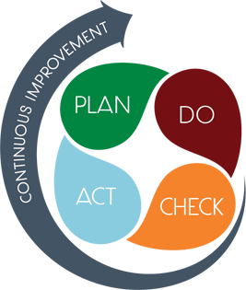
CONNECTING THE STRATEGIC PLAN & CONTINUOUS IMPROVEMENT PLAN
Strategic Plan Priority
CIP SMART Goal
Key Indicator
3. Use existing and appropriate tools to measure, analyze, and communicate student progress
By May 2026, the percentage of students graduating in 4 years will increase from 92.8% to 93.5%.
APS Graphs student reports
2. Ensure a safe and effective learning environment that encourages student engagement and quality work
By May 2026, Midtown High School will increase the CCRPI Content Mastery score for students scoring proficient and above in the following areas: Algebra Concepts & Connections- 54% to 58%, US History: 42% to 47%, and Biology from 61% to 66%
Mastery Connect Data
1. Offer a rigorous and culturally sustainable curriculum that prepares students for college, career, and civic engagement
By August 2026, Midtown High School will increase the percentage of students enrolled in Dual Enrollment, AP, and industry-certified CTAE programs by 10% from the 2024–2025 baseline, while maintaining at least an 85% AP and EOPA exam pass rate.
Student Schedules & Assessment Data

Slide 8
DATA DISCUSSION

Slide 9
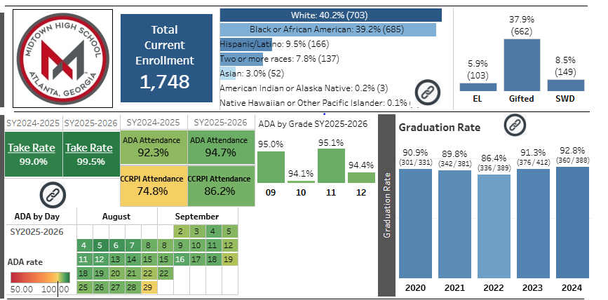
School Enrollment

Slide 10
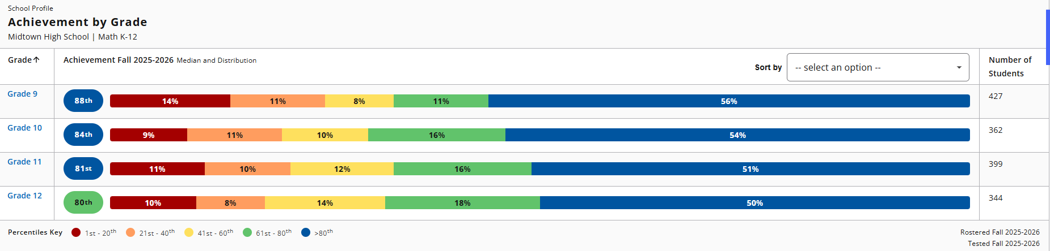
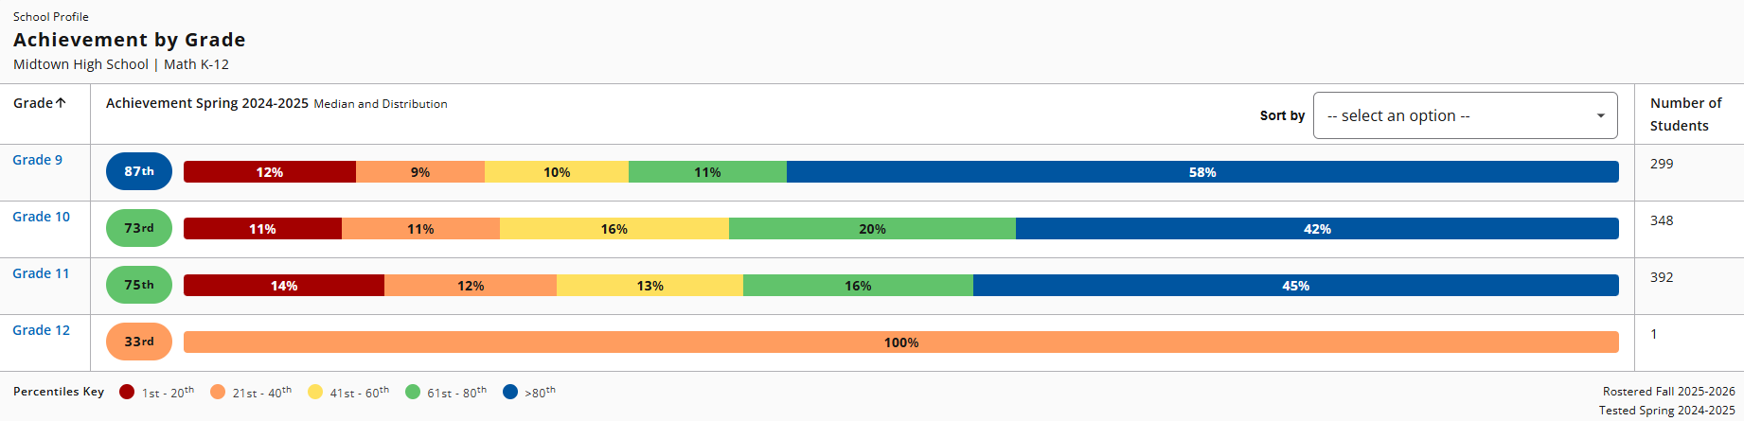
MAP RESULTS

Slide 11
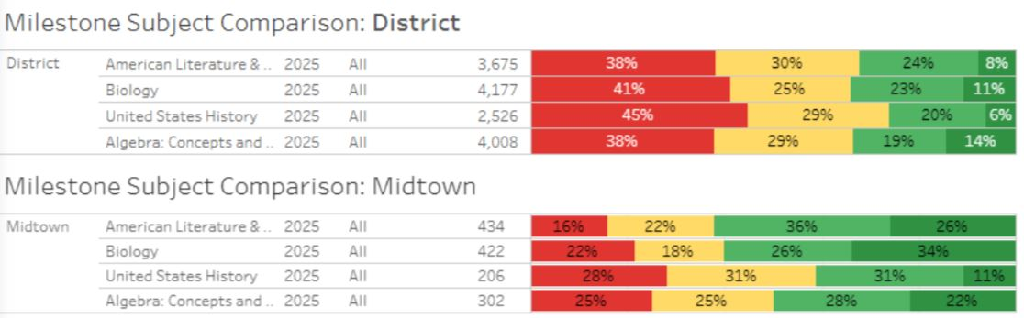
GMAS RESULTS

Slide 12
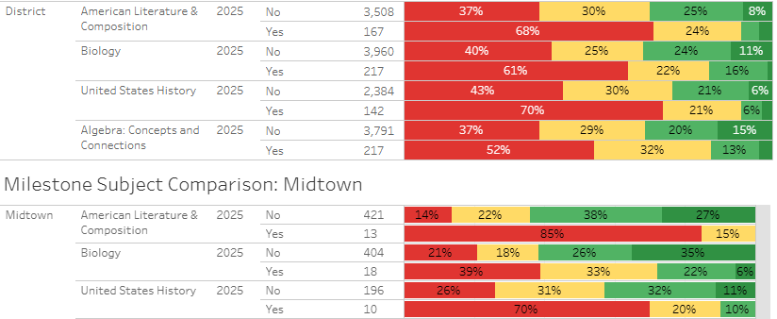
GMAS RESULTS- ELL Students

Slide 13
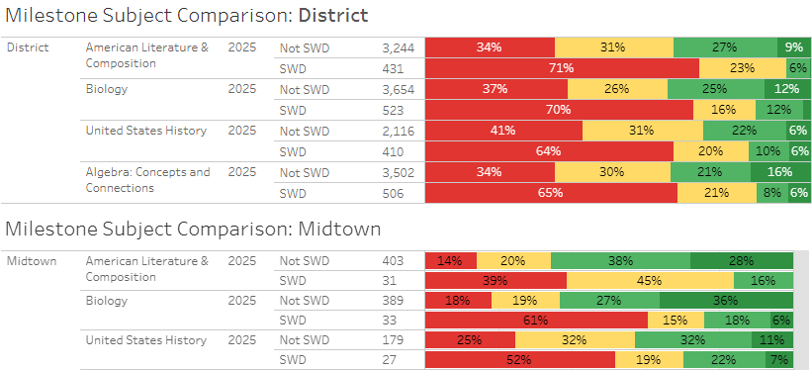
GMAS RESULTS- Exceptional Students

Slide 14
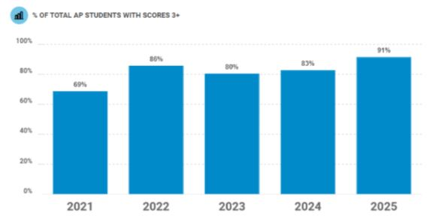
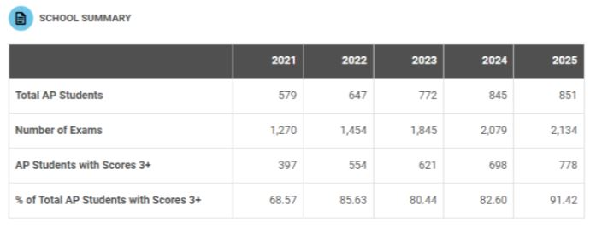
AP Data

Slide 15
AP Data by Demographic
Student Participation by Race/Ethnicity
Race/ Ethnicity | 2024 | 2025
American Indian/ Alaska Native | 3 | 1
Asian | 23 | 31
Black or African American | 101 | 110
Hispanic/Latino | 58 | 59
White | 592 | 556
Two or more Races | 58 | 77

Slide 16
AP Data by Demographic
Student Score by Race/Ethnicity (number indicates % of tests with score of 3 or higher
Race/ Ethnicity | 2024 | 2025
American Indian/ Alaska Native | 75% | 75%
Asian | 74% | 81%
Black or African American | 57% | 71%
Hispanic/Latino | 76% | 82%
White | 77% | 84%
Two or more Races | 74% | 82%

Slide 17
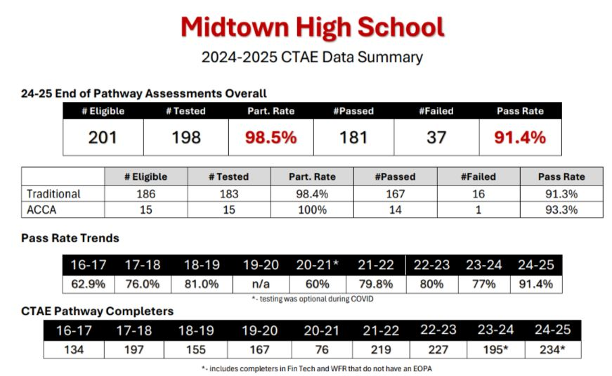
End of Pathway Assessment Data

Slide 18
GLOWS & GROWS
GLOWS
GROWS
ARE WE ON TARGET TO SUCCESSFULLY ACCOMPLISH OUR PRIORITIES?
IMPACT

Slide 19
GO TEAM DISCUSSION: DATA PROTOCOL
What do you notice?
What are your wonderings?
Based on our school’s trend data from MAP assessments and end-of-year test assessments, which student sub-groups and grade levels showed the most significant gaps or unexpected trends?
Based on our school’s trend data from MAP assessments, Milestones and other indicators, are there specific trends that require more focused attention?
What additional questions do you have?

Slide 20
Timeline for GO Teams
You are HERE
1
2
3
4
5
Fall 2021
GO Team Developed 2021-2025 Strategic Plan
Summer
School Leadership completed Needs Assessment and defined overarching needs
August
School Leadership completed Continuous Improvement Plan
Sept. – Dec.
GO Team reviews progress on current strategic plan.
GO Team develops 2025-2030 School Strategic Plan
Before Winter Break
GO Team will take action (vote) on the rank of the strategic plan priorities for SY26-27 in preparation for budget discussions.

Slide 21
QUESTIONS?

Slide 22
PRINCIPAL’S REPORT

Slide 23




LEVELING AND
FY26 BUDGET ADJUSTMENT
Template Last Revised: 9/4/2025

Slide 24

Enrollment
Projected Enrollment | 1699
15-Day Count(08.22.25) Enrollment | 1733
Difference | +34
Budget Adjustment* | $484,714
*The budget adjustment reflects the impact of the following: Enrollment changes, school reserves, Title I Part A, Title I- Family Engagement
HOLD HARMLESS
To support academic stability in schools, budgets were not reduced beyond school reserves.
Notes:
Principals: Based on your15-Day count, please give your GO Team an overview of your projected vs. 8/22 enrolled numbers as well as information on your FY26 budget adjustment.

Slide 25
PLAN FOR FY26 LEVELING RESERVE
$484,714
Priorities | Strategies | Requests | Amount
Create a welcoming, inclusive, and responsive school culture embracing the diverse communities that comprise the Midtown family. | Implementation of Chris 180 mental health and behavioral support | Reinstate Chris 180 services | $50,000
Create a welcoming, inclusive, and responsive school culture embracing the diverse communities that comprise the Midtown family. | Provide safe and welcoming school | Add additional teacher based on course need | $131,970
Notes:
Review the previously discussed plan for the FY26 Leveling Reserve as discussed by the GO Team in your Feb. 2025 Budget Feedback meeting and March 2025 Approval meeting.

Slide 26
PLAN FOR FY26 LEVELING RESERVE
$484,714
Priorities | Strategies | Requests | Amount
Use existing and appropriate tools to measure, analyze, and communicate student progress | Continue use of the Schoology, learning management system, as a clear, current, and a key tool for students and parents to support their academic success. | Additional funding for software and digital resources | $20,000
Directly solicit and act on teacher input regarding course selection, professional development, instructional resources, communication, and collegiality. | Provide the infrastructure and staffing necessary to address STEAM across the curriculum. Provide Instructional Materials and manipulatives to enhance the classroom environment. Makerspace to assist with STEAM Integration | Increase budget allocation for STEAM resources including field trips. PBL materials, professional learning, and Makerspace supplies | $20,000
Notes:
Review the previously discussed plan for the FY26 Leveling Reserve as discussed by the GO Team in your Feb. 2025 Budget Feedback meeting and March 2025 Approval meeting.

Slide 27
PLAN FOR FY26 LEVELING RESERVE
$484,714
Priorities | Strategies | Requests | Amount
Directly solicit and act on teacher input regarding course selection, professional development, instructional resources, communication, and collegiality. | Provide the infrastructure and staffing necessary to address STEAM across the curriculum. | Increase opportunities for STEAM field trips | $25,000
Directly solicit and act on teacher input regarding course selection, professional development, instructional resources, communication, and collegiality. | Provide the infrastructure and staffing necessary to address instructional practices across the curriculum. | Provide opportunities for Professional Learning aligned to strategic priorities | $15,000
Provide necessary and salient resources to enhance teaching and learning. |  | Staff Stipends | $18,938
Notes:
Review the previously discussed plan for the FY26 Leveling Reserve as discussed by the GO Team in your Feb. 2025 Budget Feedback meeting and March 2025 Approval meeting.

Slide 28
Summary of Changes as a Result of FY26 Budget Adjustment
Personnel Changes | Non-Personnel Changes
Adding Special Education Lead Teacher | Chris 180 services expanded from 3 to 5 days
 | STEAM supplies, resources, and field trips
 | Employee travel and Professional Development
 | Computer equipment and web-based licenses
 | Supplies
 | Locker room refresh
 | Overtime pay
Summary of Changes
Addition of special education lead teacher will support closing the achievement gap for students with disabilities. Non-personnel changes will support our school in having resources needed to carry out strategic plan.

Slide 29


APS Forward 2040:
Reshaping the Future of Education
Taskforce Meetings
May 8, 2025 - Presentation
August 5, 2025- Presentation
Upcoming Public Meetings
October 20
November 10
Virtual – at Noon
In-person at 6PM at CLL (130 Trinity Ave)
UPDATE
Comprehensive Long-Range Facilities Plan
atlantapublicschools.us/APS2040
Notes:
Next on our agenda, we’d like to welcome our representative to the Long-Range Comprehensive Facilities Master Plan Taskforce. As many of you know, this taskforce plays a key role in shaping the future of our district’s facilities — ensuring they are aligned with projected enrollment, instructional needs, safety standards, and long-term community use."
Over the summer, the taskforce has been hard at work reviewing data, exploring options, and engaging in important planning conversations. [Name of Representative] will share an update on what’s been done so far, any key decisions or recommendations that have been made, and what’s ahead — including opportunities for the public to provide input.
[Allow the FMP representative to provide an update and answers questions. After this is concluded:]
Thank you [Name of Representative].
A report will be presented to the Board at its August 11 meeting, and the options will become public the week of August 18.
There are several upcoming public meetings where you can learn more and share your thoughts. The next public meetings are scheduled for: August 25, October 20, and November 10
On each date, there will be a virtual meeting at noon and an in-person meeting at the Central Office at 6PM.
I strongly encourage you all to attend these meetings. This is a critical time for public input, and your voice is essential.

Slide 30
Requested Information from GO Team Members
Encouraged Early Release/Late Arrival/ Dual Enrollment
Addition of A Building
Paved additional parking lot
Added staff as needed (Instructional and non-instructional)
Created additional office space
Floating teachers without dedicated classroom

Slide 31
SAVE THE DATE
IN-PERSON
G3 Summit
Go.Grow.Govern.
Bring the full GO Team
Come ready to collaborate, contribute, and create the future!
Saturday
September 27
8:30 AM – 2:30 PM
Come learn more about:
Your school’s 2025-2030 Strategic Plan
Stakeholder Engagement
Charter System
…and much more
Atlanta College & Career Academy
1090 Windsor St SW
Notes:
Before we move on, I want to highlight an important upcoming event: the G3 Summit on Saturday, September 27 at the Atlanta College and Career Academy.
We need as many GO Team members as possible to attend — this is a critical opportunity to come together, in person, and shape the future of our schools. Strategic planning for 2025–2030 is underway, and your voices, ideas, and leadership are essential.
You’ll be learning about your school’s new strategic plan, best practices for stakeholder engagement, and how this work connects to APS Forward 2040 — plus much more.
Please save the date and plan to attend! Come ready to collaborate, contribute, and create the future together.
More information will be coming soon.

Slide 32
QUESTIONS?

